Slide 1

ELEVATOR in NuSMV
Fontana Emanuele

Slide 2
What is temporal logic?
Temporal logic is a system for reasoning about propositions that change over time. Unlike classical logic, it includes temporal operators like:
G (Globally): A condition holds always.
F (Finally): A condition will hold at some point in the future.
X (Next): A condition holds at the next moment.
U (Until): One condition holds until another becomes true.
R (Release): One condition must hold as long as another does
It’s often used in computer science for verifying systems, ensuring processes follow rules over time.
Linear Temporal Logic (LTL) focuses on single timelines, while Computation Tree Logic (CTL) considers branching paths, allowing for multiple potential futures.

Slide 3
What is a model checker?
A model checker is a verification tool used in computer science to automatically check whether a system meets certain specifications or properties. It systematically explores all possible states of a system model, typically described in terms of states and transitions, to verify that certain conditions hold throughout its execution.
Using temporal logic (like LTL or CTL), model checkers can assess properties such as safety (nothing bad happens) and liveness (something good eventually happens). If the system violates a specified property, the model checker provides a counterexample—a sequence of states that demonstrates the failure. This makes model checking especially valuable for verifying hardware designs, software protocols, and safety-critical systems.

Slide 4
What is NuSMV?
NuSMV is an open-source model checker used to verify finite-state systems against specifications written in temporal logic, like LTL (Linear Temporal Logic) and CTL (Computation Tree Logic). It’s designed for analyzing the correctness of system models, such as hardware circuits, communication protocols, and safety-critical software, ensuring they meet desired properties.
NuSMV systematically explores all possible states in a system model and checks them against the specified properties. If a property fails, NuSMV provides a counterexample trace that shows how the violation occurs, which is helpful for debugging and refining the model

Slide 5

CASE STUDY ELEVATOR
The purpose of this exercise is to model a lift through LTL and verify certain properties using NuSMV.
The lift is located in a 4-storey building and it’s described by:
floor -> current floor
requested -> floor to be reached
door -> door status
direction -> direction of movement
In the SMV file, logic was implemented to regulate the operation of the doors, the current floor and the movement of the lift

Slide 6
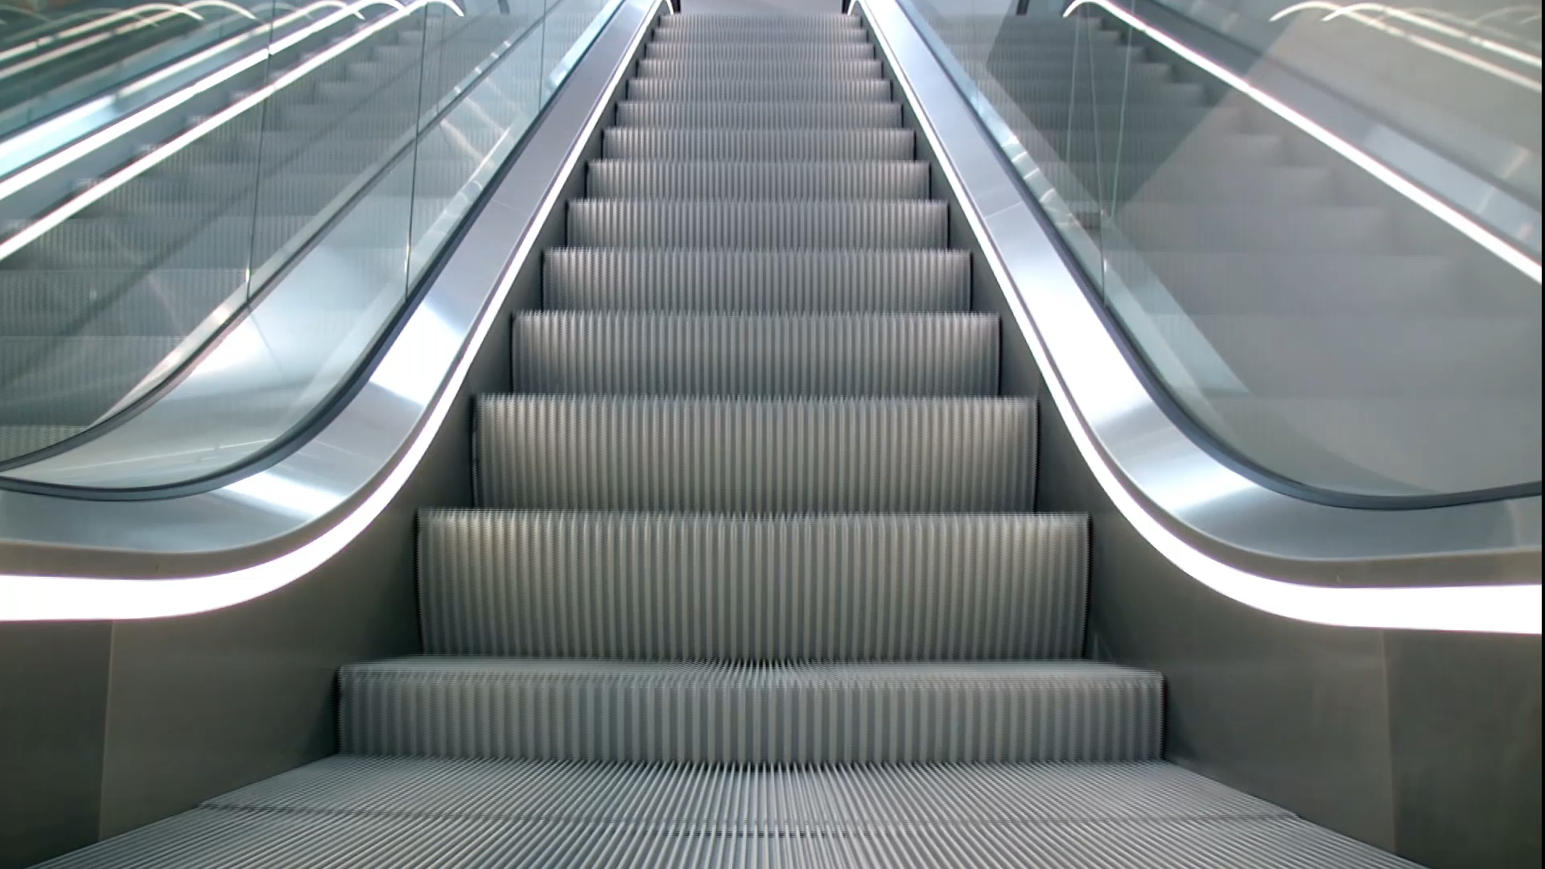
Elevator specifications:
The specifications to be checked are as follows:
The elevator should note move if the door is open
Whenever the door is open, it will eventually be closed
Whenever the door is closed, it will eventually be open
The elevator con move upward only if the floor is not the highest
The elevator con move downward only if the floor is not the lowest
The elevator can visit any floor infinitely often
When a floor is requested, the elevator will eventually stop at the floor
When the elevator is traveling upward, id does not change its direction when there are passengers waiting to go to a higher floor
When the elevator is traveling downward, id does not change its direction when there are passengers waiting to go to a lower floor

Slide 7
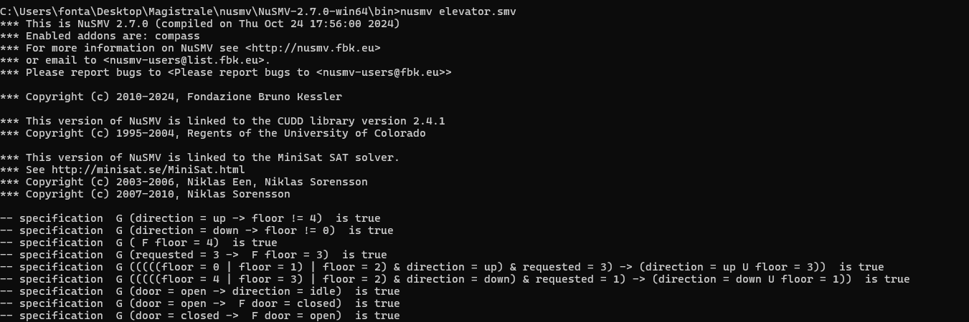
Results As we can see, all the specifications are met

